Slide 1
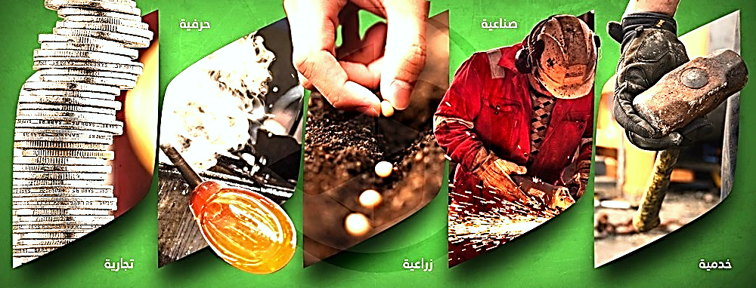
صندوق حياة
للـتمــويـل الأصــغـــر
HAYAT Microfinance Fund
Microfinance Risk Management in Crisis

Slide 2
Poverty In Syria
5.3 Million before War
Notes:
The number of poor people in Syria has increased significantly during the current crisis, as shown in UN study conducted in 2010 which says that there were 5.3 million poor people in Syria. However, this number had doubled due to the non-existence of the large-scale economic facilities such as factories, large markets, and government services, this led the workers who used to work in these facilities to join the daily expanding sector of unemployed.

Slide 3
Massive Displacement
Notes:
Affected by conditions of war and poverty, millions of Syrians emigrated to many of neighboring countries and to the rest of the world looking for asylum and a safe life in which they could find food security and can raise and educate their children without fear of death. In these countries, most of them had to work in jobs do not suit their academic specialization and skills, besides many of them internally displaced

Slide 4
Dying looking for Safe Life

Slide 5
UN Bulletins
5.3 Million Refugees
7 Million IDPs
Notes:
United Nations Bulletins says that the number of registered Syrian refugees became more than 5.3 million Syrians, besides 7 million Syrians have been internally displaced to relatively safer areas.

Slide 6
Relief Efforts
Notes:
In response to this humanitarian disaster; local and international organizations implemented relief programs to provide food, shelter, clothing, education, and health. These efforts have greatly reduced the impact of the disaster on the Syrian people, but on the other hand, two basic problems have arisen: the limitation of these relief programs and the lack of coverage for all those needy and affected people. The second problem is the full dependence of some of the beneficiaries on relief programs, neglecting of their specialties, skills, and experience.

Slide 7
Syrians are Active
Notes:
Syrians by nature are hardworking and active people, they always look for decent jobs.

Slide 8
Syrians Markets
Notes:
Therefore, we see after every bombing targeting the markets; the next day they resume their activities.
The famous markets that were active in Aleppo city the economic capital of Syria, moved to alternative safer areas in the nearby countryside and new jobs were created based on the new reality imposed by the current circumstances.

Slide 9
Syrian Companies
Notes:
As for the countries to which the Syrian people have resorted, the numbers show that the companies established by Syrians in Turkey has exceeded 10,000 companies, and in Egypt 565 companies.

Slide 10
Microfinance
Notes:
We chose to work first on the category of entrepreneurs with Microfinance approach (Alqard Alhasan free interest rate) for several reasons including:
1. The nature of the Syrian situation in terms of the inability to implement large projects because of war, and in order to distribute the risk and not concentrate a huge amount of money in a specific area.
2. The need for various economic projects in the light of limitation of funding and the desire to cover as many beneficiaries as possible.
3. The great contribution of small enterprises globally in the economics of both of developing and advanced countries which produce many of the products we use.
4. The inability of the Syrians in the current stage to bear excessive financial burdens such as Murabaha and others, and the inability of institutions to cover excess labor necessary for the work of Islamic Finance.

Slide 11
Notes:
The idea of ​​Microfinance was not accepted by donors at first, because this approach was new to some institutions, and due to donors focus on emergency response to displacement, asylum and humanitarian relief operations, the answer was always it’s too early, and sometimes they remark that we as individuals have good experience in this field, but as an institution we do not have enough experience in this type of projects, then the arguments have become that the establishment of such a project depends on credit at the current stage is very difficult because of the absence of state authority to ensure repayment, also the absence of banking system in Syria manages financial transfers from outside to inside Syria, but anyone has experience in Microfinance knows that the most successful projects have been in pockets of poverty in the Third World Countries were not controlled by governments, even in the countries who have full control on all of their territories; the reliance on government support is minimal because of that these kind of projects always conducted by NGOs and CBOs depending on the ways of social solidarity methods, and that legal proceedings did not have the expected impact on defaulting management.

Slide 12
The Seed
Notes:
However, finally, we were able to convince some donors to try this approach in small amounts, and on 14th/Abril/2014, the seed of the Hayat Fund project was planted under the name of "BENAA" project with support of several donors and a staff of 12 people covering 23 towns in Aleppo's western countryside, and ATAA Humanitarian Relief has covered the financial and operational costs of this project for 3 years, with remarkable success and repayment rate of over 98%.

Slide 13
Target Area

Slide 16
Notes:
At the beginning of the current year, this successful approach was presented to a number of donors, and this endeavor culminated at “Syria's Developmental Vistas Conference” organized by ATAA Humanitarian Relief by announcing the initiative of Al-RAHMA Global to establish HAYAT Microfinance Fund.
After this introduction about the background of HAYAT Fund, we’ll move to our main topic.
Of course, many of you are wondering about how we manage the risks in HAYAT Fund in the current circumstances in Syria; well….

Slide 17
HAYAT Fund Establishment

Slide 18
Microfinance for Early Recovery

Slide 19
Macroeconomic Level
Notes:
Credit Risks

Slide 20
Microeconomic Level

Slide 21
Notes:
Finally, we realized that we need to educate our people about Borrowing Culture, and the proper management of debt and cash for their projects, looking forward to our strategic vision which is to transform HAYAT Fund into a full-service financial bank that provides integrated financial services to re-energizing economic life in order to ease the suffering of our people, which lasted seven painful years.

Slide 22
Notes:
بسم الله الرحمن الرحيم
وقل اعملوا فسيرى الله عملكم ورسوله والمؤمنين
Thank you for listening

